Slide 1

Supreme Court Debate
Your debate statement is:
‘It should be illegal for police forces to keep fingerprints and DNA samples from innocent people’

Slide 2
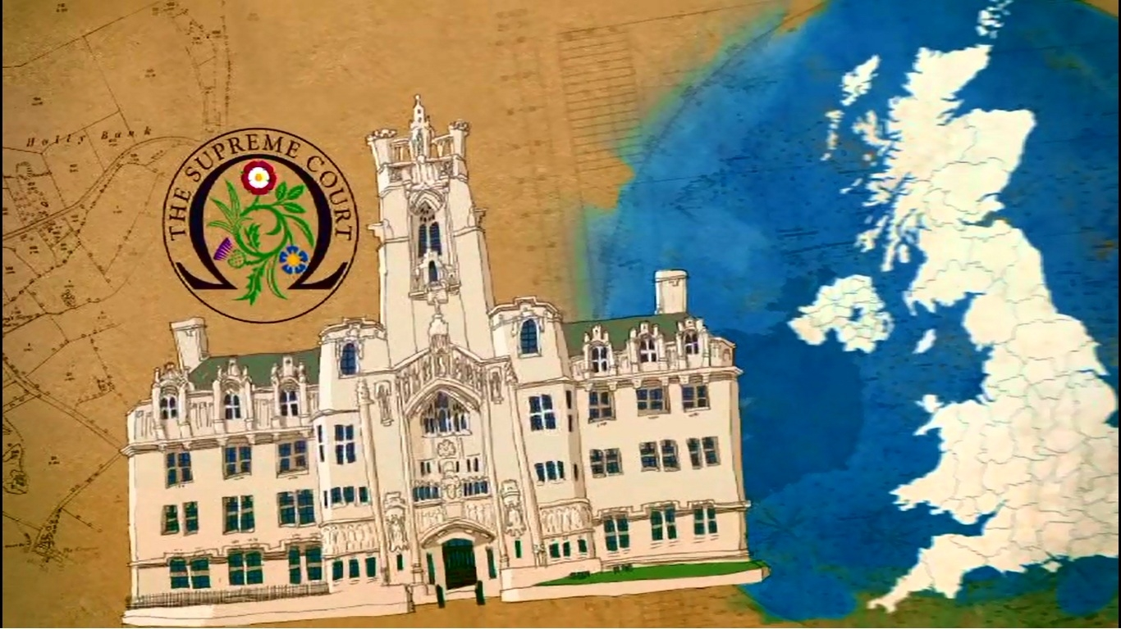
The Supreme Court is the highest court of appeal in the United Kingdom.
It opened on 16th October 2009.
There are 12 Supreme Court Justices in total.
Each case must have an arguable point of law of general public importance.
Some of the recent key cases include the right to die, prenuptial agreements, religious discrimination and privacy.

Slide 3
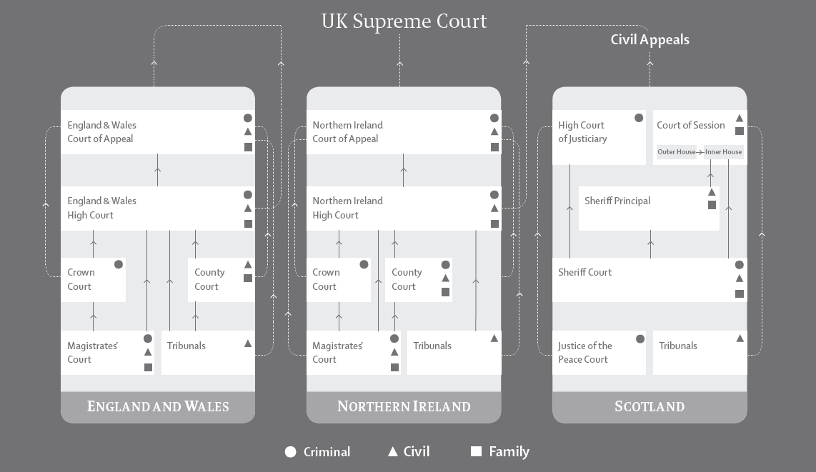
A case must go through several courts before it makes it to the Supreme Court
Please watch the Supreme Court introductory video: http://www.supremecourt.uk/introductory-film.html
What route would a civil case take to come to the Supreme Court in England and Wales?

Slide 4
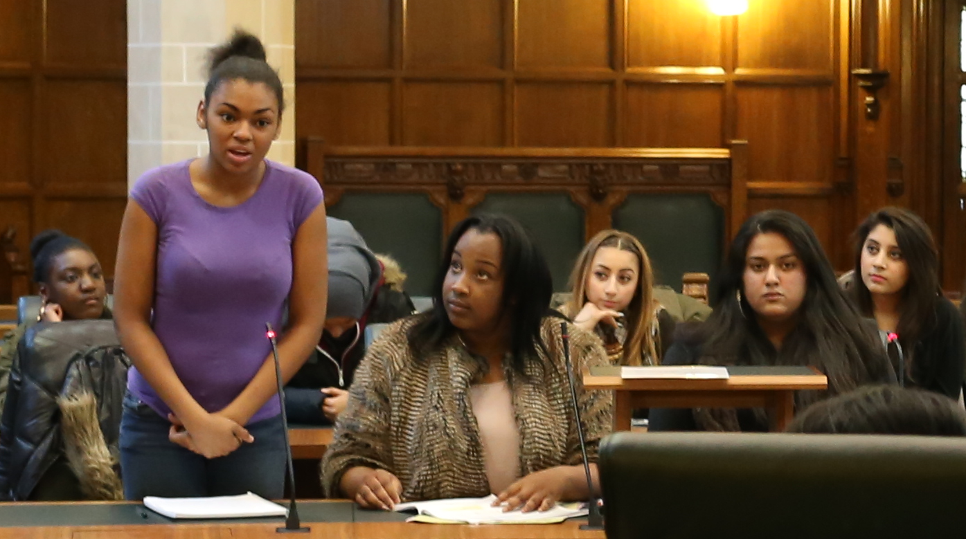
YOUR DEBATE
‘It should be illegal for police forces to keep fingerprints and DNA samples from innocent people.’
When a suspect is arrested for a recordable offence, a mouth swab and fingerprints are taken, using a sterile kit and fingerprint scanner.
The swabs are transferred to a science laboratory where chemicals are added to turn the it into a unique DNA barcode.
This is then stored electronically in the National DNA database run by the National Policing Improvement agency.

Slide 5
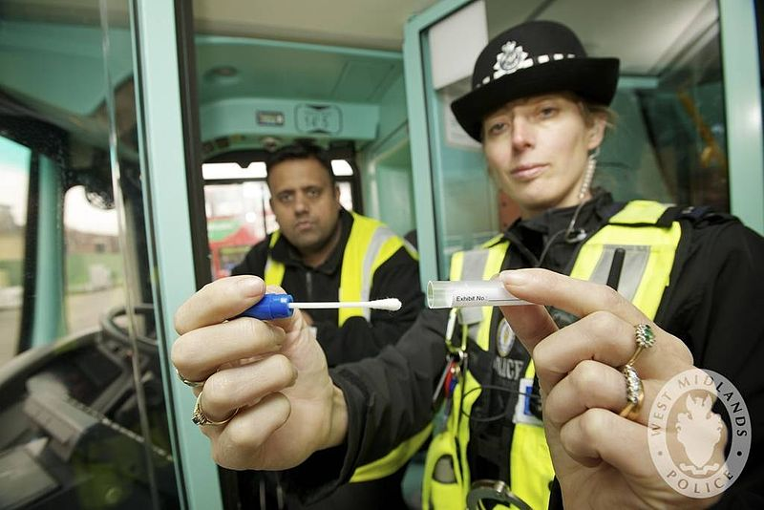
Photograph courtesy of West Midlands Police
Every new sample put into the DNA database is automatically checked against those already there. If there is a match the police force that took the initial swab will be alerted by e-mail.
All DNA that is taken from crime scenes, is also stored nationally, and each new sample will be automatically checked against the human DNA that has been stored to see whether there is a match.

Slide 6
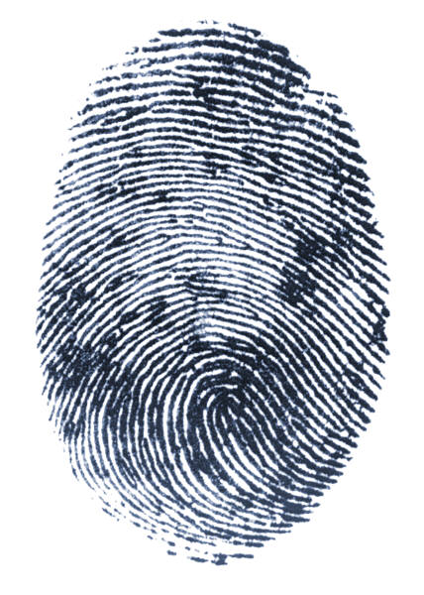
The Law
The Police and Criminal Evidence Act 1984 (PACE) required that samples of DNA and fingerprints taken from a person in connection with a crime must be destroyed if that person is cleared of that crime.
In 2001 the law changed and the Criminal Justice and Police Act 2001 replaced the provision for the destruction of samples. Instead a new clause stated samples ‘may be retained after they have fulfilled the purpose for which they were taken’. This was followed by guidelines issued by Association of Chief Police Officers (ACPO) providing that data should only be destroyed in exceptional cases.

Slide 7
Following a case dismissal by the Appellate Committee of the House of Lords (the highest court of appeal before the creation of the Supreme Court) The European Court of Human Rights in the case R (S) v Chief Constable of the South Yorkshire Police and R (Marper) v Chief Constable of Police found that the retention of DNA data and fingerprints by the Police was not justified and therefore incompatible with Article 8 of the Human Rights Act: the Right to Respect for Private and Family Life.

Slide 8
Supreme Court case details
Case 1
In December 2007, GC was arrested on suspicion of common assault on his girlfriend. He denied the offence. A DNA sample, fingerprints and photographs were taken after his arrest. On the same day he was released on police bail without charge and was subsequently informed that no further action would be taken.
Case 2
In March 2009, C was arrested on suspicion of rape, harassment and fraud. His finger prints and a DNA sample were taken. He denied the allegations. He was charged in respect of the rape allegation but no further action was taken in respect of the harassment and fraud allegations. In the Woolwich Crown Court in May 2009, the prosecution offered no evidence and C was acquitted.

Slide 9
    In both cases, the appellants requested the destruction of the DNA data that was taken.
Their requests were refused as there were no exceptional circumstances within the meaning of the ACPO guidelines.
The appellants issued proceedings for judicial review (the ability to challenge a public body through the courts) on grounds that, in light of the ruling in Marper ECtHR, the retention of the DNA was incompatible with their article 8 rights.
In the circumstances, the Divisional Court dismissed the applications for judicial review but granted a certificate that the cases were appropriate for a leap frog appeal to the Supreme Court.
What other public bodies can be challenged under
judicial review?

Slide 10

Appealing to the Supreme Court
The cases came to the Supreme Court, and were heard together as they contained the same issue or ‘point of law’
R (on the application of GC) (FC) (Appellant) v The Commissioner of Police of the Metropolis (Respondent) and R (on the application of C) (FC) (Appellant) v The Commissioner of Police of the Metropolis (Respondent)
They came as a ‘test case.’ A test case is a term to describe a case that tests how valid a particular law is. Test cases are useful because they establish legal rights or principles and thereby serve as precedent for future similar cases.
Can you think of any other examples of test cases?

Slide 11

Article 8
Article 8 protects the private life of individuals against arbitrary interference by public authorities and private organisations such as the media. It covers four distinct areas: private life, family life, home and correspondence.
Article 8 is a qualified right, so in certain circumstances public authorities can interfere with the private and family life of an individual. These circumstances are set out in Article 8(2). Such interference must be proportionate, in accordance with law and necessary to protect national security, public safety or the economic wellbeing of the country; to prevent disorder or crime, protect health or morals, or to protect the rights and freedoms of others.

Slide 12

Percentage of total population on a police DNA database in 2005
The facts and information provided are correct at the time the case was heard in 2011
Percentage of total population on DNA database in 2005
France 0.2%
Germany 0.44%
Spain 0.01
USA 0.99
Canada 0.23
United Kingdom 5.23
By 2010, the National DNA Database contained computerised DNA profiles and linked DNA samples from approximately 6 million individuals in the UK, including Scotland and Northern Ireland (nearly 10% of the UK population).
In 2007, Baroness Scotland confirmed to the Home Affairs Committee that three-quarters of the young black male population would soon be on the DNA database.
http://www.genewatch.org/sub-539481 22/08/2014

Slide 13

More facts and information correct at the time the case was heard in 2011
Does DNA solve crime?
Less than 1% of crimes are solved with the help of DNA profiles.
DNA comes into its own in cases where a profile recovered from a crime scene later connects a suspect to the offence.
The most obvious examples are an attacker's DNA on the hilt of a knife, a burglar's hair snagged on a window or semen recovered from a rape victim.
DNA plays a role in solving a third of cases like these, where a crime scene sample is loaded onto the database and later linked to a suspect.
What are the figures?
The database provides some 3,500 matches to crime scenes every month.
Between April 1998 and September 2009, DNA profiling provided matches to 410,000 crimes.
Between 2007-08 police successfully gathered DNA profiles relating 83 killings, 184 rapes and a further 15,420 crimes they went on to solve.
http://news.bbc.co.uk/1/hi/uk/7532856.stm 20/08/14

Slide 14
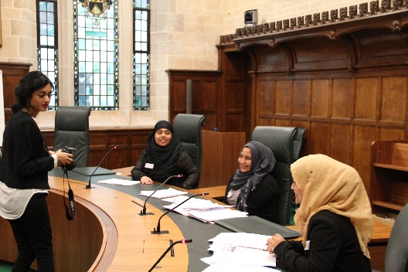
Debate roles
You will be split into one of the following teams:
Justices Team
The justices’ job will be to listen carefully to the appellants and respondents during their debate, ask questions and eventually decide which side has been the most persuasive. There must be an odd number of justices.
Appellant Team
The appellant team is usually ‘pro’ the debate proposition. They will be the lawyers in the case and will take it in turns to present arguments, respond to the respondents’ arguments and answer the justices’ questions.
Respondent Team
The respondent team is usually ‘anti’ the debate proposition. They will be the lawyers in the case and will take it in turns to present arguments, respond to the appellants’ arguments and answer the justices’ questions.
Timetable for debate
50 min debate preparation
30 min debate
Appellants 8 min
Respondents 8 min
Appellant 4 min
Justices 10 min to consider and deliver judgment

Slide 15
A lawyer or judge would always prepare for a case. So now its time for your own research.
Supreme Court website:
http://supremecourt.uk/
For more information about courts in the UK:
http://www.justice.gov.uk
Background news articles relevant for the time of the case
Q&A: The national DNA database
http://news.bbc.co.uk/1/hi/uk/7532856.stm
DNA and fingerprint guidelines ‘unlawful
http://www.bbc.co.uk/news/uk-13440012
DNA retention judgment won’t see discriminatory policy destroyed
http://www.guardian.co.uk/commentisfree/libertycentral/2011/may/18/dna-retention-supreme-court-police
DNA Database: Key Case Studies
http://news.bbc.co.uk/1/hi/uk/8037972.stm
Judgments
http://www.supremecourt.uk/decided-cases/docs/UKSC_2010_0173_Judgment.pdf
http://www.supremecourt.uk/decided-cases/docs/UKSC_2010_0173_PressSummary.pdf

